Slide 1
Optimal Traffic Light Control for a Single Intersection
Bart De Schutter
Proceedings of the 1999 American Control Conference, San Diego, California, pp. 2195-2199, June 1999.
Presenter: Shiuan-Wen Chen
Date: Mar. 21, 2007

Slide 2
ABSTRACT
We consider a traffic light controlled intersection. First we construct a model that describes the evolution of the queue lengths (as continuous variables) in each lane. Next, we discuss how optimal and suboptimal traffic light switching schemes (with possibly variable cycle lengths) for this system can be determined. We also show that for a special class of objective functions suboptimal traffic light switching schemes can be computed very efficiently.

Slide 3
1. Introduction
In this paper we study the optimal traffic light control problem for an intersection of two two-way streets.
We derive an approximate model that describes the evolution of the queue lengths as a continuous function of time.
Starting from this model we can then compute the traffic light switching scheme that minimizes a criterion, thereby augmenting the flow of traffic and diminishing the effects of traffic congestion.
The main difference of the approach presented in this paper and most other existing methods is that we allow the green-amber-red cycle time to vary from one cycle to another.

Slide 4
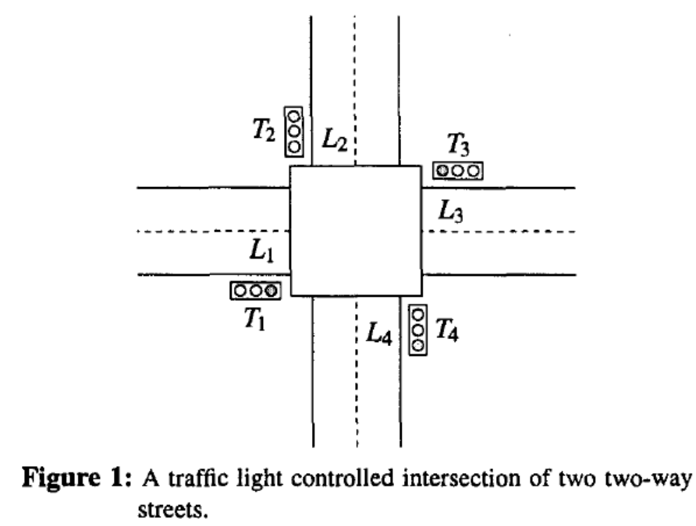
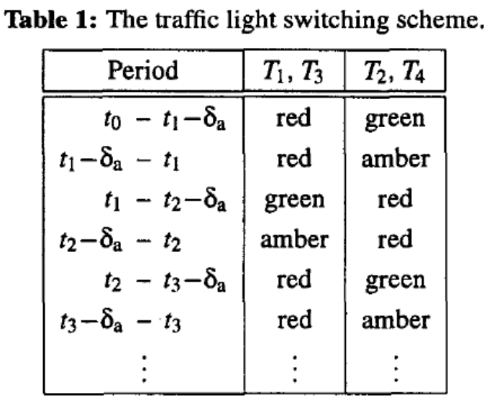
2. The set-up and the model of the system
For each traffic light there are three subsequent phases: green, amber, and red. We assume that the duration of the amber phase is fixed and equal to δ_{a}.

Slide 5
2. The set-up and the model of the system
Let l_{i}(t) be the queue length (i.e., the number of cars waiting) in lane L_{i} at time instant t . In reality l_{i}(t) will be an integer valued function and the arrival and departure rates will vary as a function of time.
We make the following assumptions:
  the queue lengths are continuous variables,
  in each main phase the average arrival and departure rates of the cars are constant,
  for each lane the average departure rate during a green phase is greater than or equal to the average departure rate during the subsequent amber phase.

Slide 6
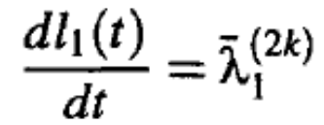



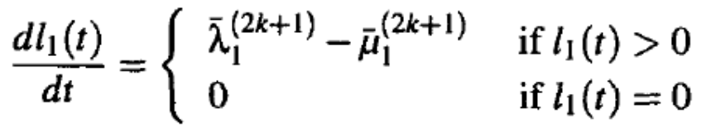

2. The set-up and the model of the system
Define δ_{k} = t_{k+l} - t_{k} .
Consider lane L₁. When the traffic light T₁ is red, there are arrivals at lane L₁ and no departures. Hence,
In the time interval (t_{2k+l},t_{2k+2}) the traffic light T₁ is green and there are arrivals and departures at lane L₁. Since the net queue growth rate is and since the queue length cannot be negative, we have

Slide 7

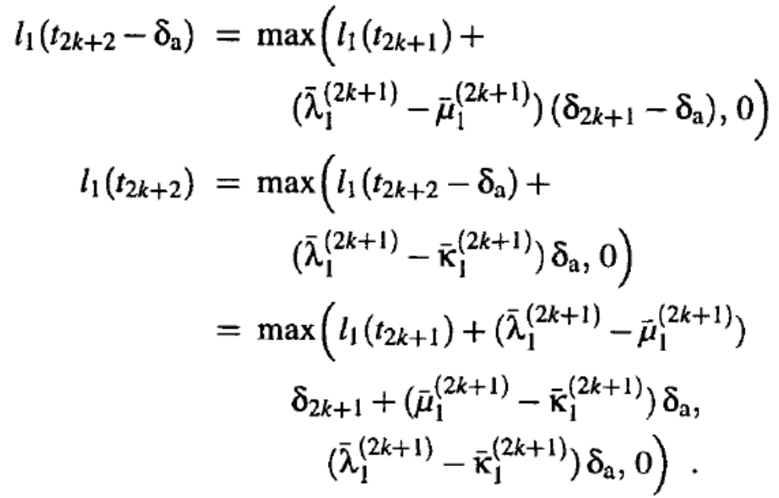
2. The set-up and the model of the system
We can write down a similar expression for the amber phase

Slide 8


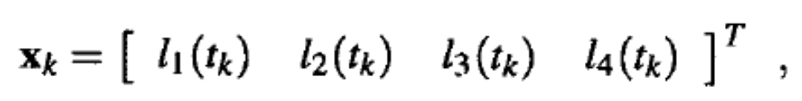
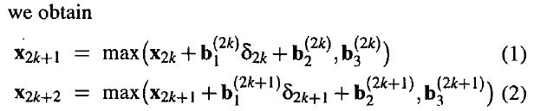
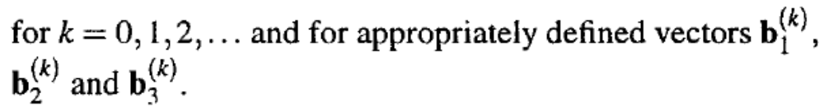
2. The set-up and the model of the system
Note that we also have
We can write down similar equations for l₂(t_{k}), l₃(t_{k}) and l₄(t_{k}).
So if we define

Slide 9
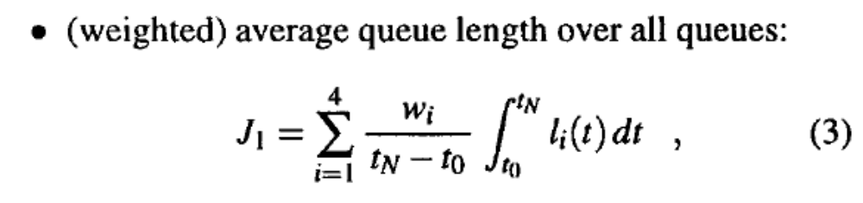
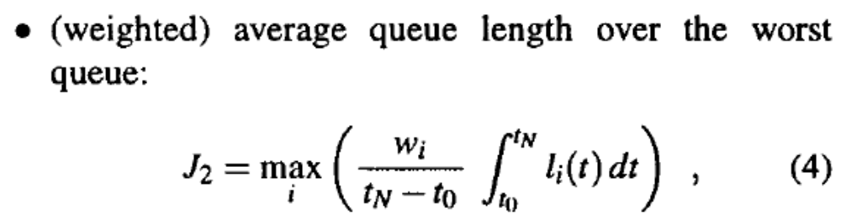
3 Optimal traffic light control
From now on we assume that the average arrival and departure rates in each main phase are known.
For a given integer N we want to compute an optimal sequence t₀, t₁, . . . , t_{N} of switching time instants that minimizes a criterion such as:

Slide 10
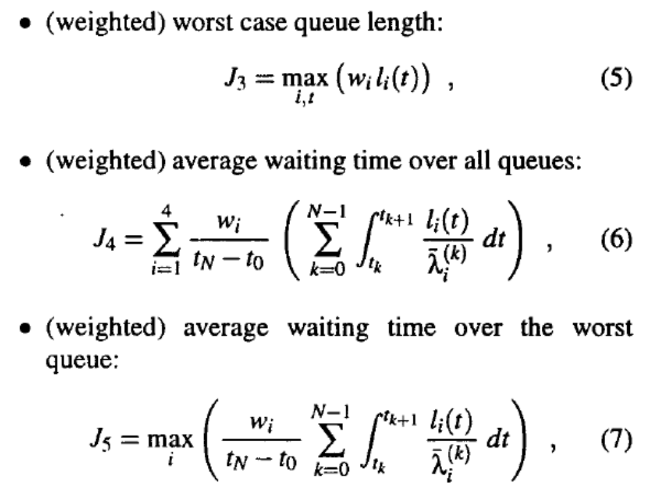

3 Optimal traffic light control

Slide 11
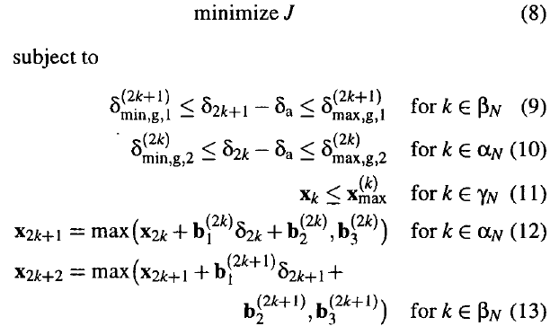
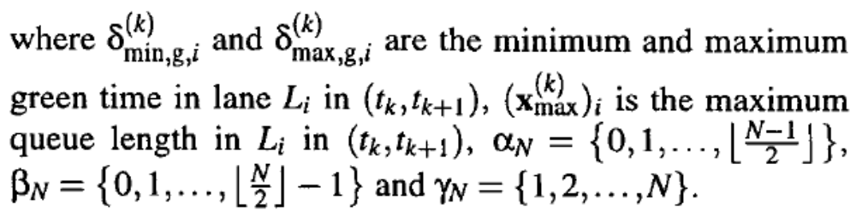
3 Optimal traffic light control
This leads to the following problem:

Slide 12
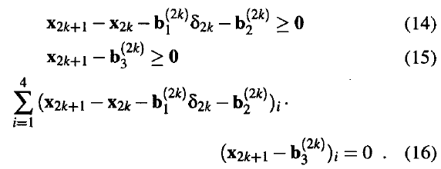
3 Optimal traffic light control
Now we discuss some methods to solve problem (8) - (13).
Consider (12) for an arbitrary index k. It is easy to verify[3] that this equation is equivalent to:
We can repeat this reasoning for (13) and for each k.

Slide 13
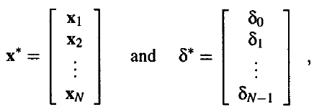
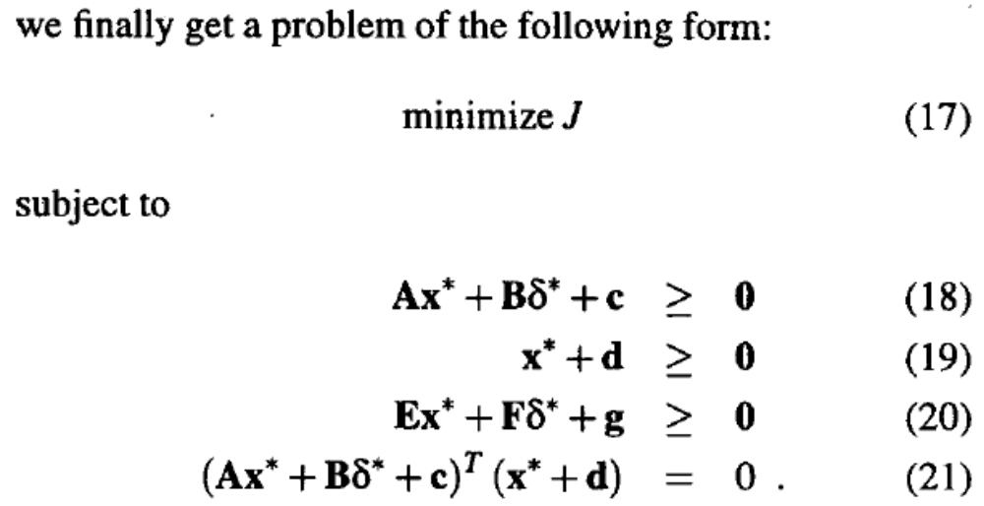
3 Optimal traffic light control
So if we define

Slide 14
3 Optimal traffic light control
The system (18)-(21) is a special case of an Extended Linear Complementarity Problem (ELCP) [1].
In [1] we have developed an algorithm to compute a parametric description of the complete solution set of an ELCP.
Once this parametric description is obtained, we can compute for which combination of the parameters the objective function J reaches a global minimum.
However, since the general ELCP is an NP-hard problem [l], the ELCP based approach is not feasible if the number of switching cycles N is large.

Slide 15
3 Optimal traffic light control
If N is large, we could consider a small number N_{s} of switching cycles, compute the optimal switching strategy with the method given above, implement the first step(s) of this strategy, and recompute the optimal switching strategy for the next N_{s} switching cycles.
This approach is called the multi-ELCP approach.
Note that although this is feasible in practice, it will only give a suboptimal solution.

Slide 16
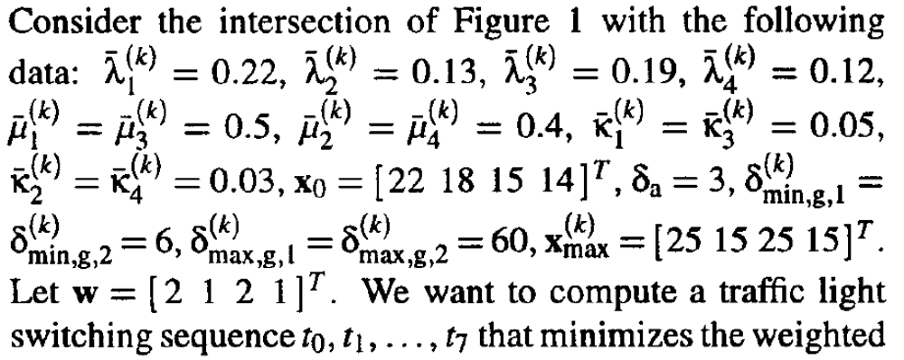

4 Example

Slide 17
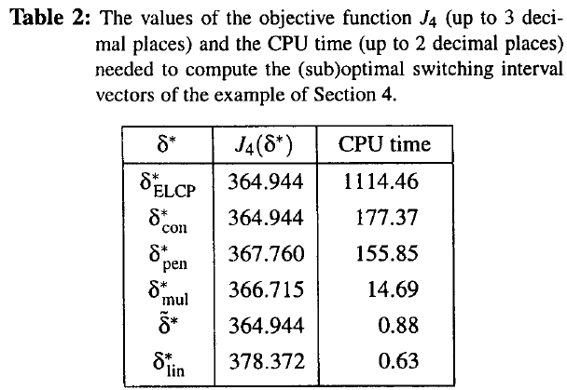
4 Example
N_{s}=3
The CPU time needed to compute the switching interval vectors on a SUN Ultra 10 300 MHz workstation with the optimization routines called from MATLAB and implemented in C or Fortran.

